Slide 1


Slide 2

Predicting House Prices with Supervised Learning
This presentation covers how supervised learning helps predict accurate house prices.
We will explore key concepts, models, data features, and evaluation methods.

Slide 3

What is Supervised Learning?
Definition
Example
Learning from labeled data to predict outcomes.
Training on past house sales to predict prices.
Types
Regression predicts continuous values, focus here.

Slide 4
Why Predict House Prices?
Buyers
Sellers
Investors
Estimate fair price
Set competitive price
Identify opportunities
Negotiate effectively
Sell faster
Find undervalued properties

Slide 5
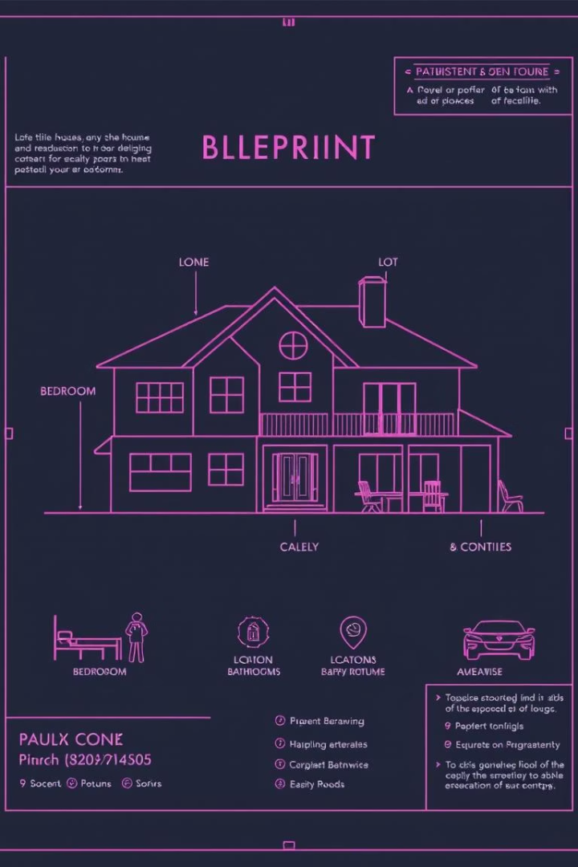
Key Data Features
Bedrooms & Bathrooms
Indicate size and capacity.
House Size
Primary indicator of living space.
Location
Major impact on value.
Age & Amenities
Newer homes and features add value.

Slide 6
Data Preprocessing
Handle Missing Values
1
Impute or remove incomplete data.
Convert Categorical Data
2
Use one-hot encoding for locations.
Feature Scaling
3
Normalize numerical values for consistency.
Split Data
4
Divide data into training and testing sets.

Slide 7
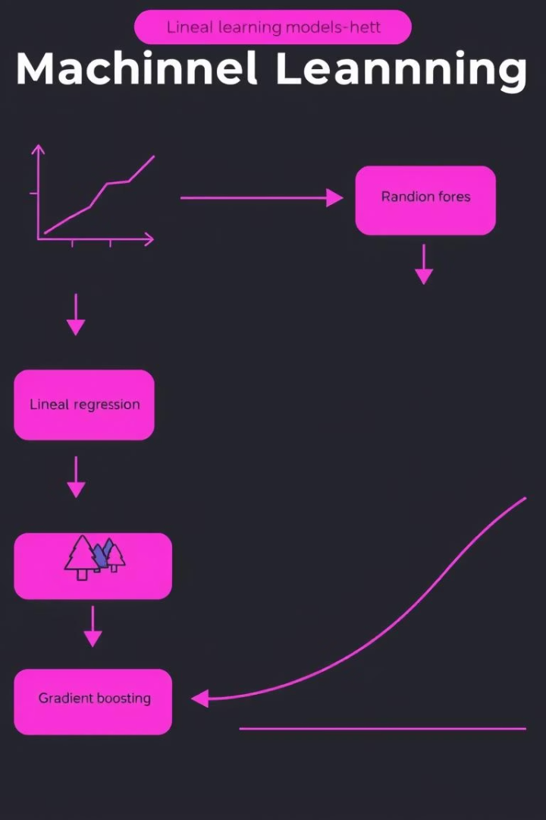




Choosing a Model
Linear Regression
Decision Tree
Random Forest
Captures complex, non-linear relationships.
Ensemble improves accuracy and robustness.
Simple and interpretable baseline model.
Gradient Boosting
High performance ensemble method.

Slide 8




Making Predictions
Train Model
Fit chosen model to training data.
Predict
Generate prices for new houses.
Visualize
Compare predicted vs. actual prices graphically.

Slide 9
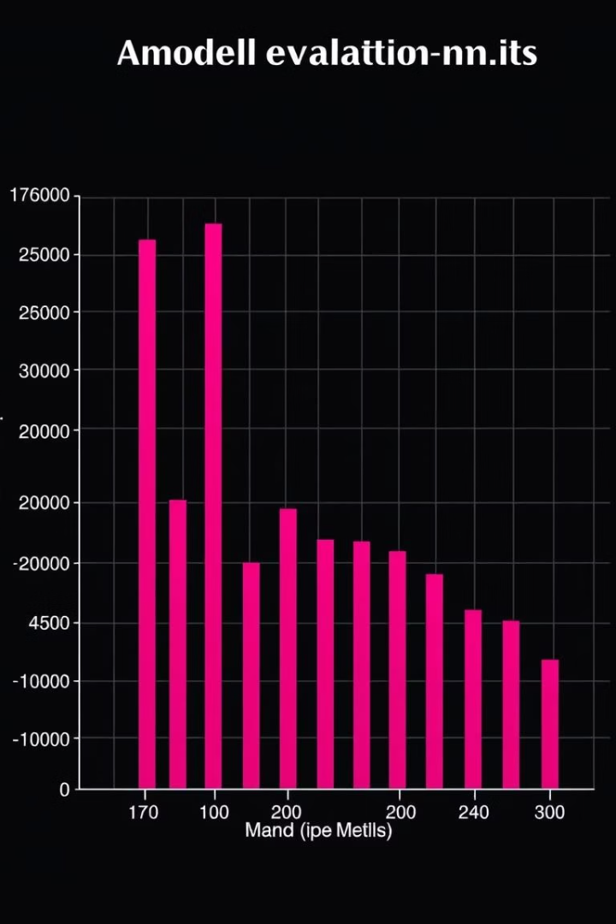
Evaluating the Model
Mean Squared Error
R-squared
Explains variance percentage the model captures.
Measures average squared prediction error.
Residual Analysis
Check patterns in prediction errors for improvement.

Slide 10

Conclusion
Supervised learning predicts house prices effectively with quality data.
Careful feature selection and evaluation improve model accuracy.
Applications include real estate, investing, and financial planning.

Slide 11
Thank you

